Slide 1
Employee Data Analysis using Excel
STUDENT: NAME: K.YASMIn
REGISTER NO: 312216522 autunm1647cb1221647022
DEPARTMENT: B.COM(BM)
COLLEGE: R.B.GOTHI JAIN COLLEGE FOR WOMEN

Slide 2
PROJECT TITLE
Employee Performance Analysis using Excel

Slide 3


AGENDA
Problem Statement
Project Overview
End Users
Our Solution and Proposition
Dataset Description
Modelling Approach
Results and Discussion
Conclusion
3/21/2024 Annual Review

Slide 4

PROBLEM STATEMENT
Employee performance analysis using Excel involves evaluating
and measuring an employee’s work effectiveness and efficiency
based on key performance indicators (KPIs). This data is then
analyzed using Excel‘s functions and tools, such as pivot tables,
Charts, and conditional formatting, to identify patterns, strength,
And areas for improvement. The analysis helps in making
Informed decisions regarding training needs, promotions, and
Overall workforce optimization.

Slide 5

PROJECT OVERVIEW
.
The project “Employee Performance Analysis Using Excel” aims to systematically evaluate employee productivity and effectiveness by leveraging Excel’s analytical tools. The project will involve collecting and organizing performance data such as task completion rates, accuracy, and attendance records. The outcome will help in identifying top performers, recognizing training needs, and making data-driven decisions for performance improvement. The final deliverable will include a detailed report and visual dashboards for easy interpretation and strategic planning.

Slide 6
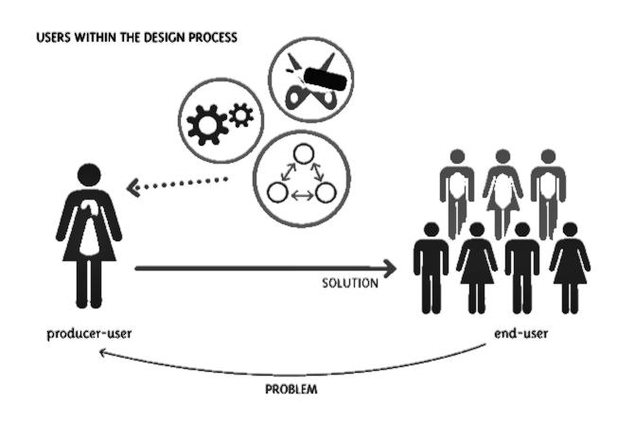

WHO ARE THE END USERS?
Organisation
Emplyee manager
HRM

Slide 7
OUR SOLUTION AND IT’S VALUE PROPOSITION
Data insight Enables managers to make informed decisions Based on Accurate
real time performance data.Impovere efficient the Data collection and analysis the process.
Better performance analysis helps in recognition of Performance in Addressing
the Under Performance analysis the unlimited data

Slide 8
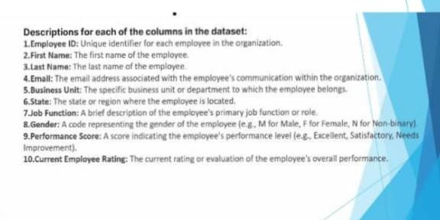
Dataset Description

Slide 9
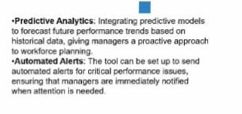

THE "WOW" IN OUR SOLUTION
3/21/2024 Annual Review
9

Slide 10
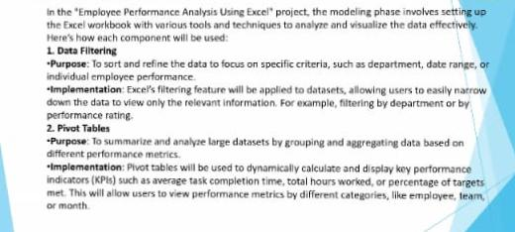
MODELLING
10

Slide 11
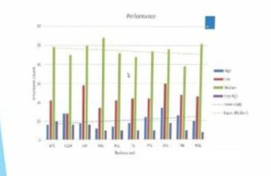
RESULTS
11

Slide 12
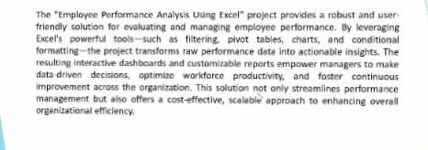
conclusion

